Slide 1
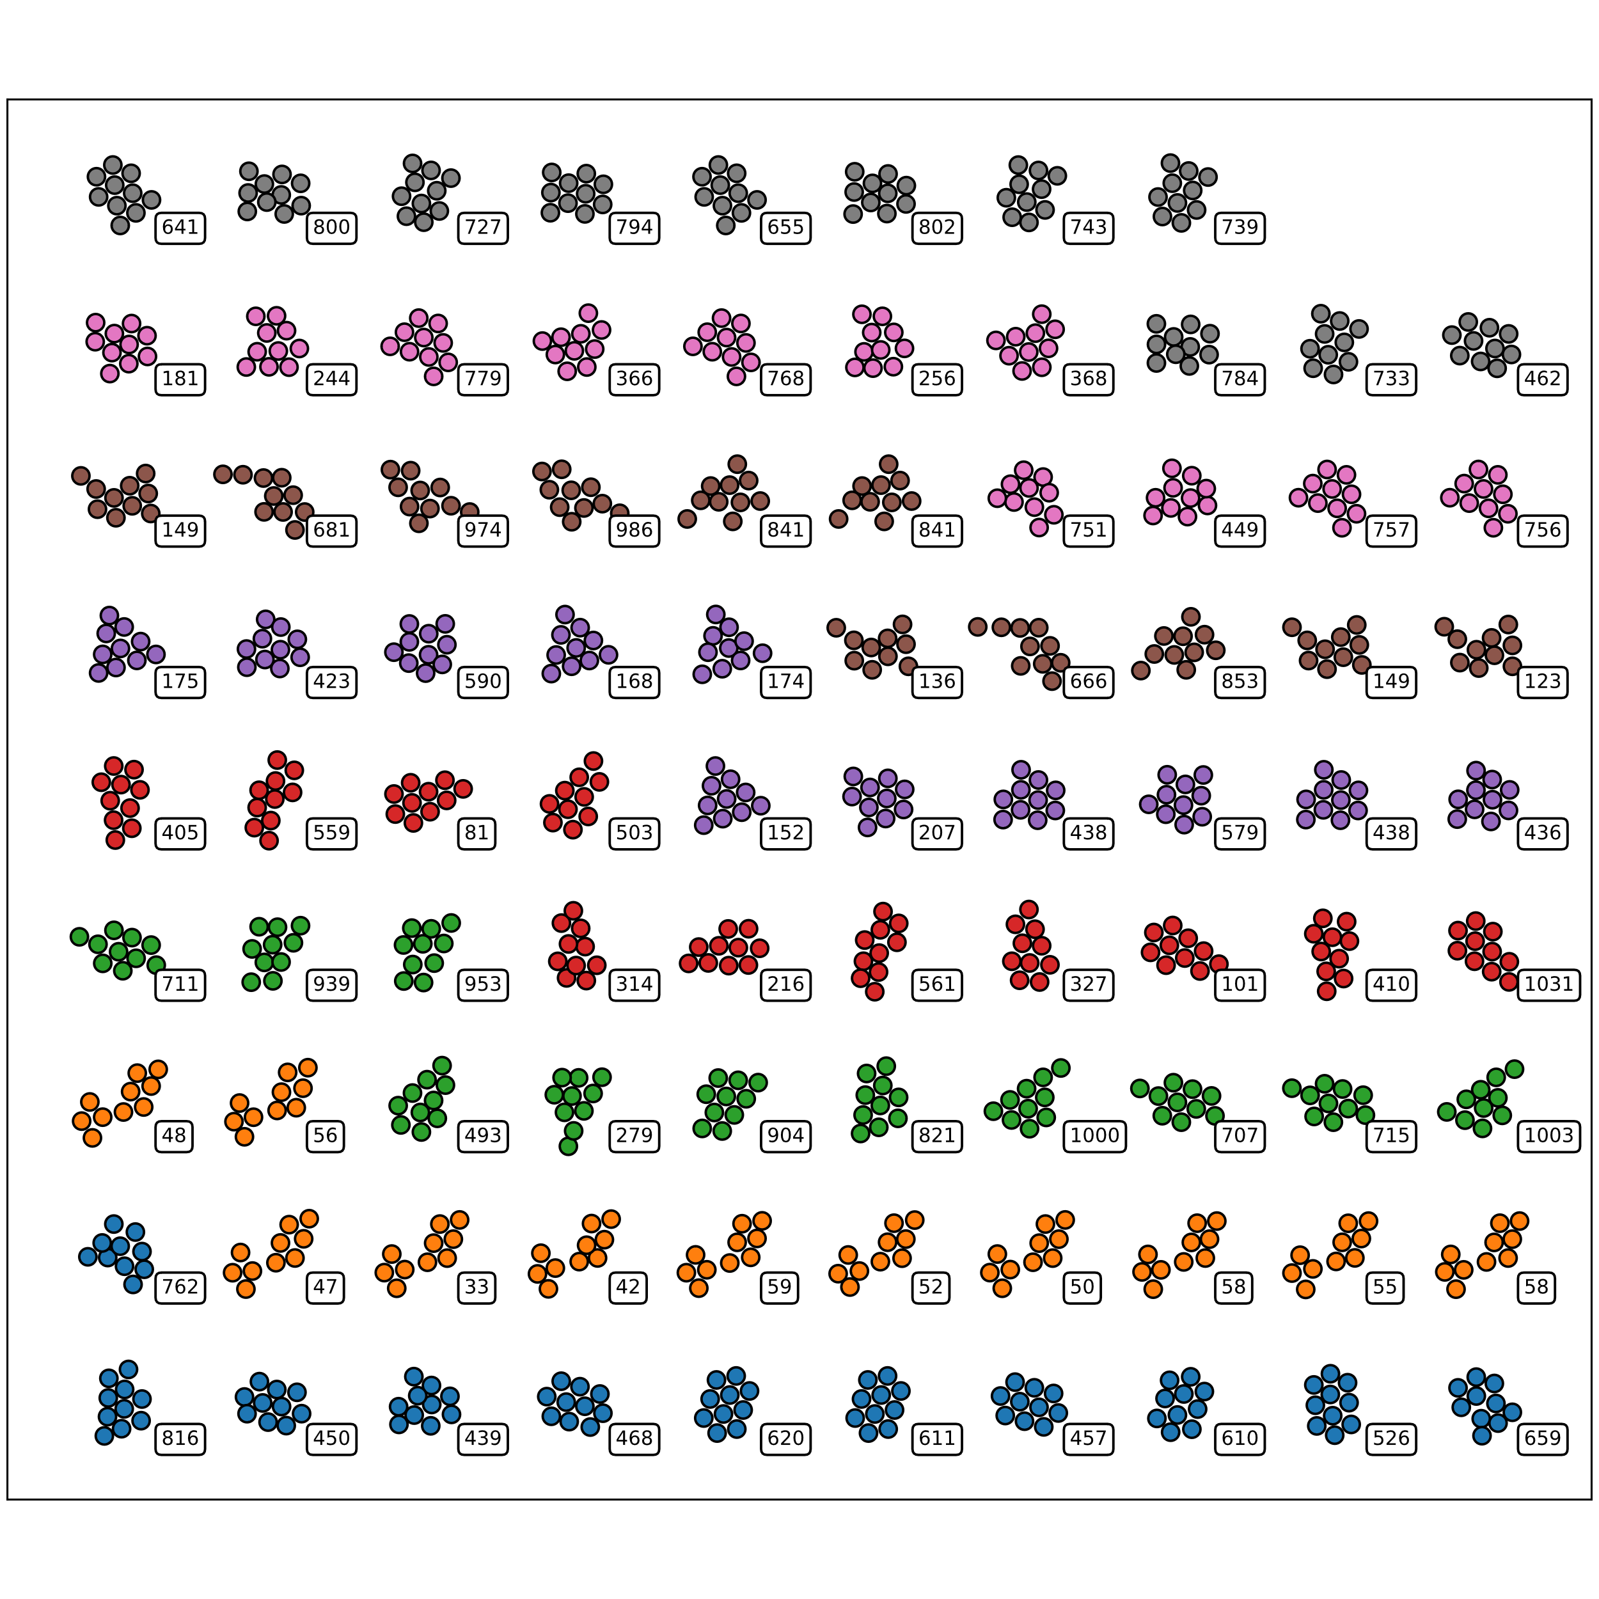
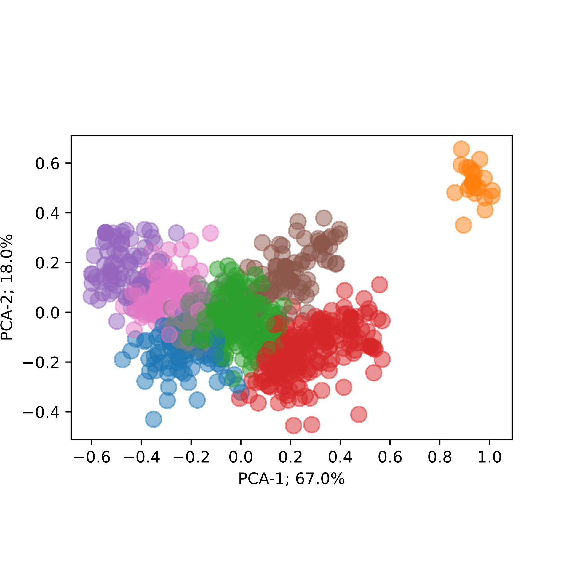
Clustering & Classification

Slide 2
Introduction to clustering & classification
Goal: Understand clustering & classification
Clustering → grouping similar data into clusters
We need a ”finger-print” of data → Descriptors
Need to obey certain symmetries
Having found descriptor → How do we then classify?
Helpful tool: Principal Component analysis (PCA)
Two strategies: Supervised- vs. Unsupervised learning.
Cross-entropy
Let’s go through some examples.

Slide 3
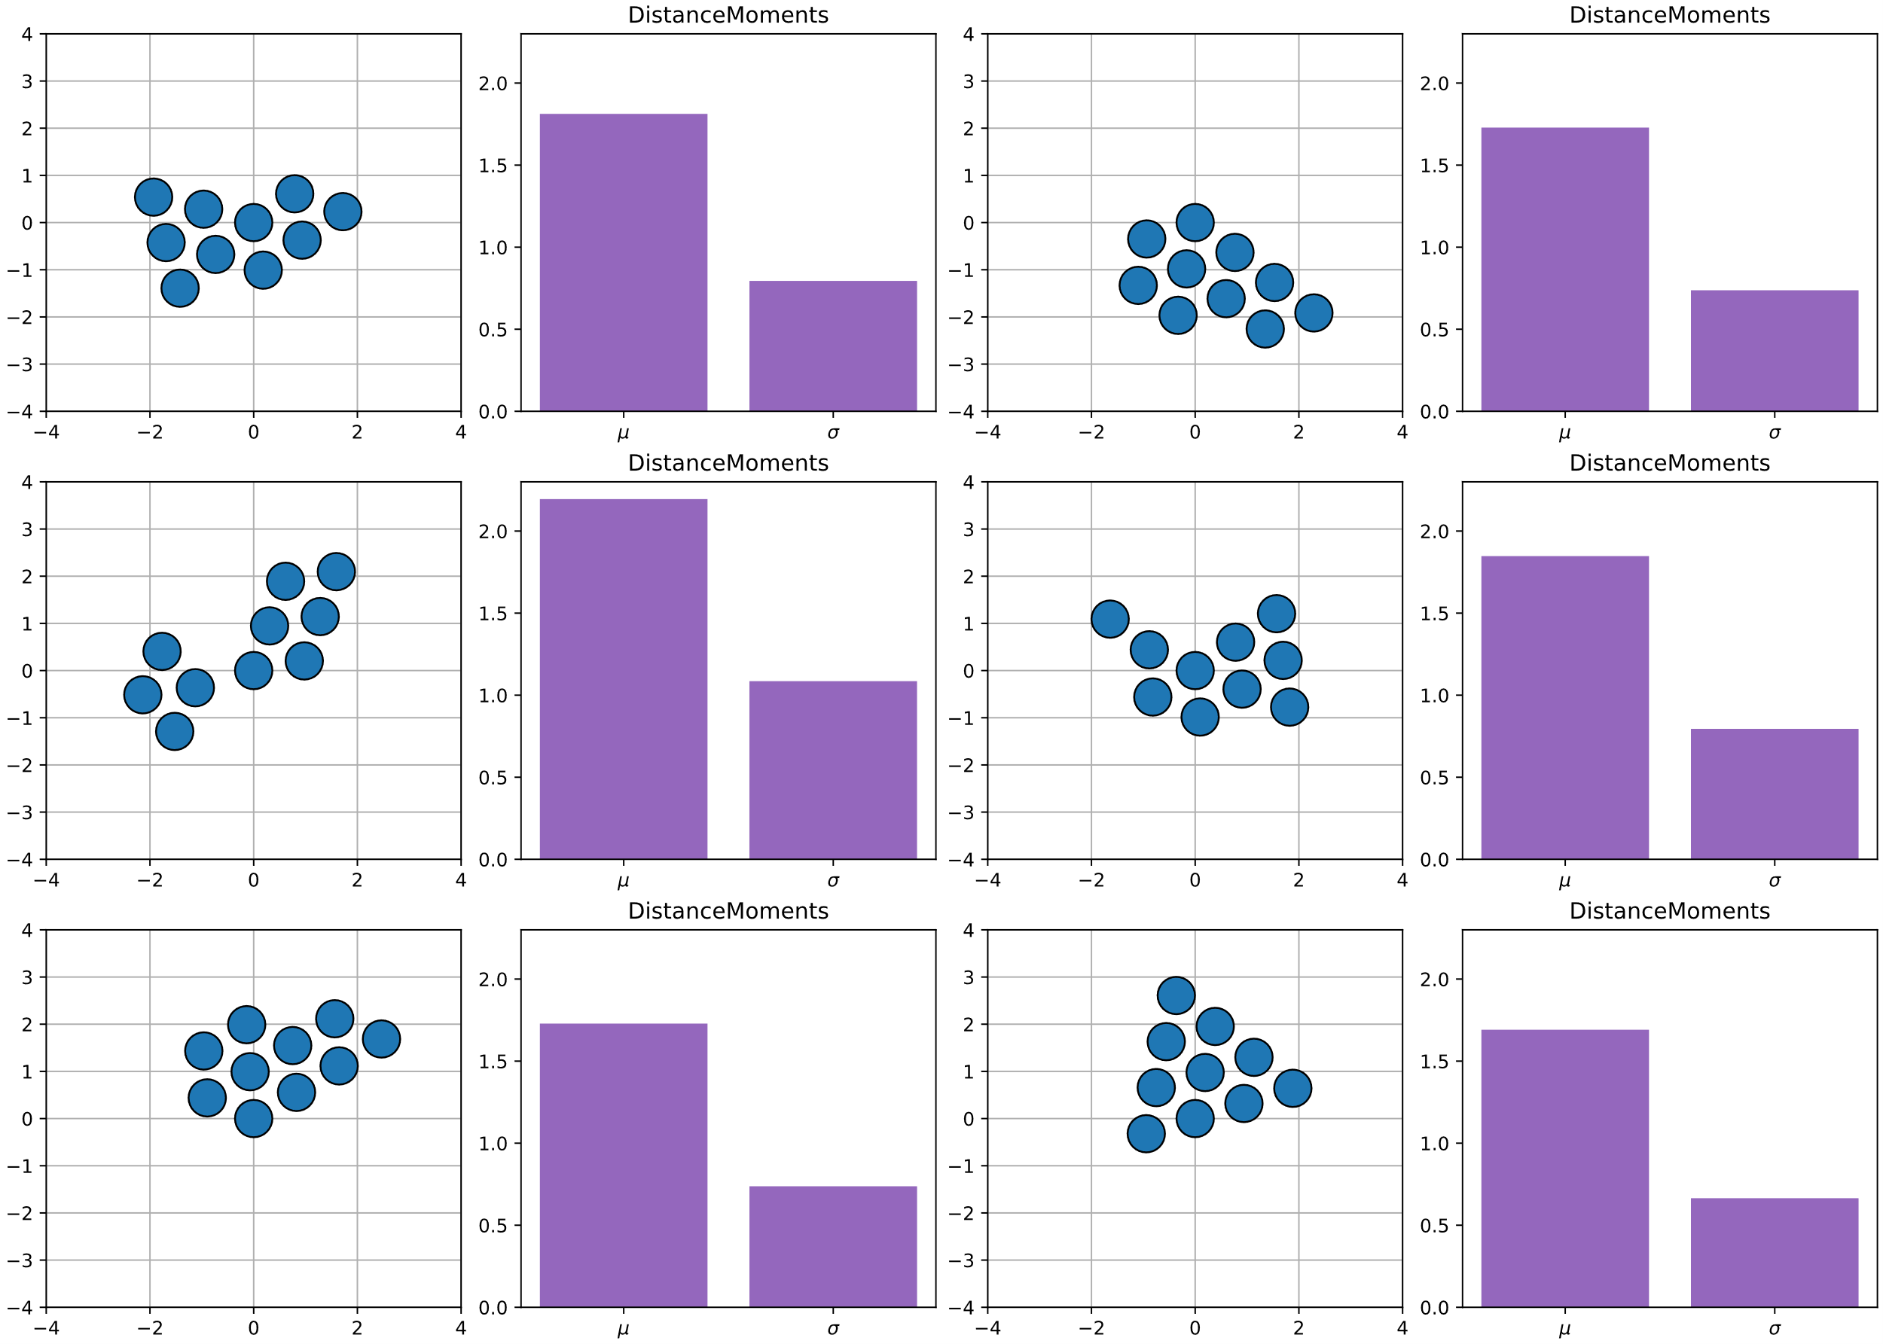
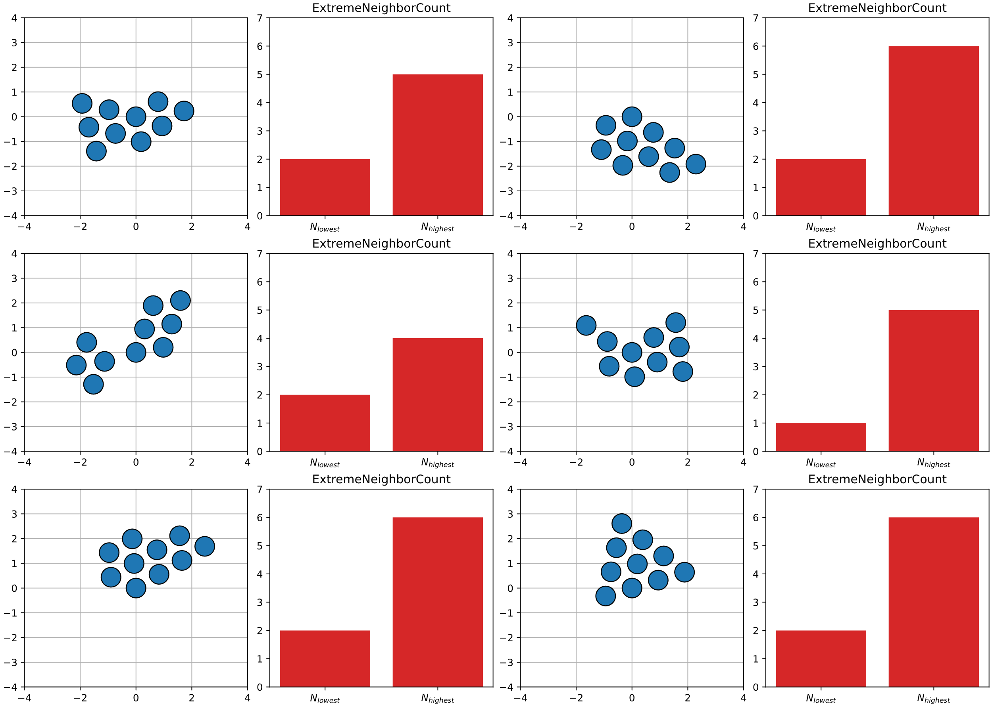
Distance Moments & Extreme neighbor counting

Slide 4
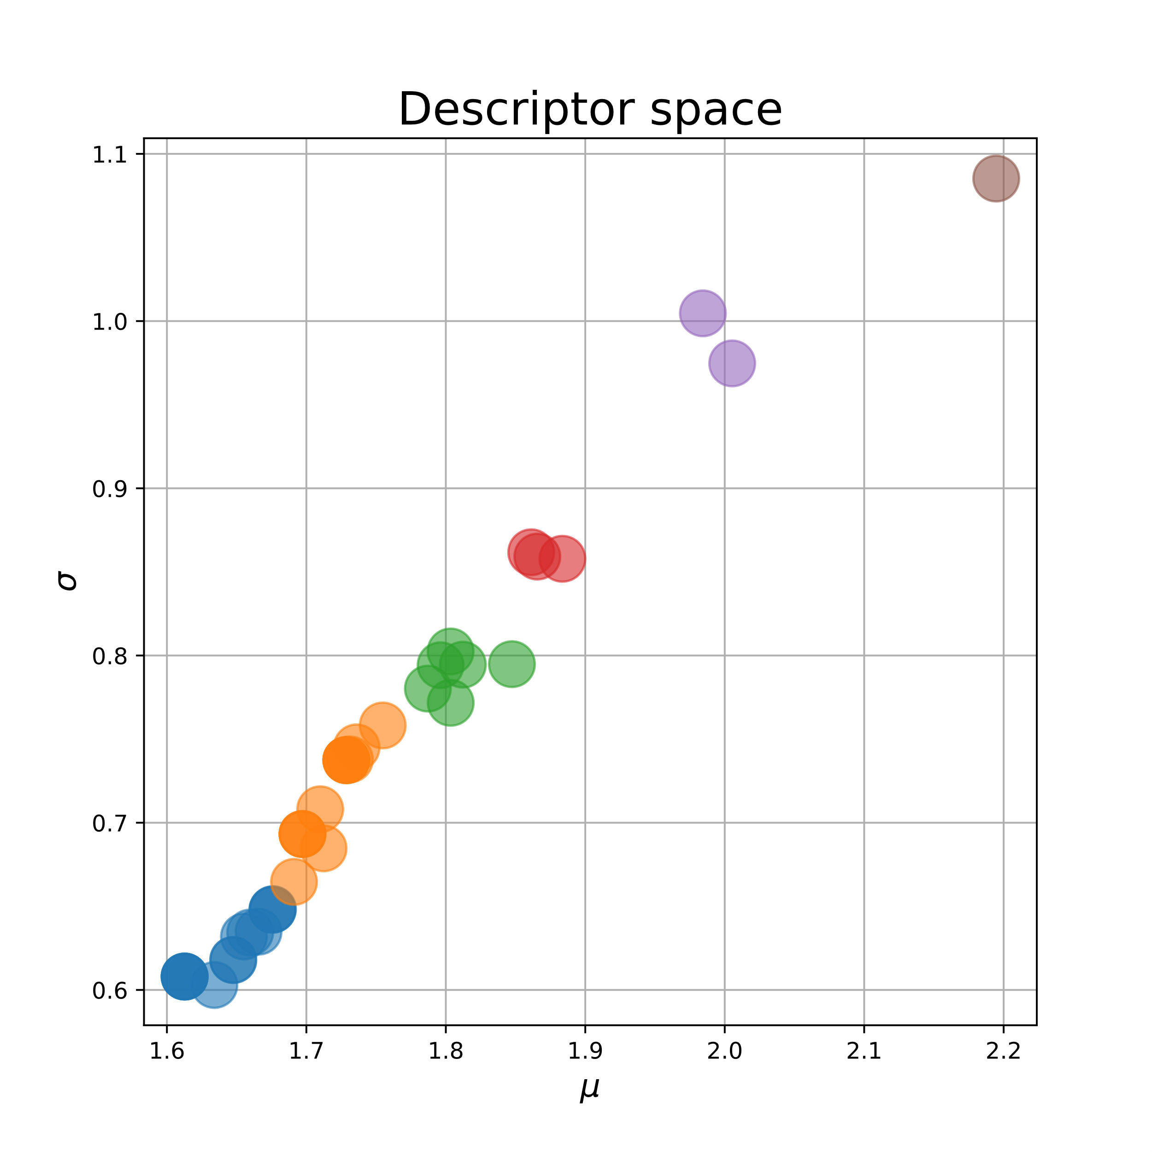
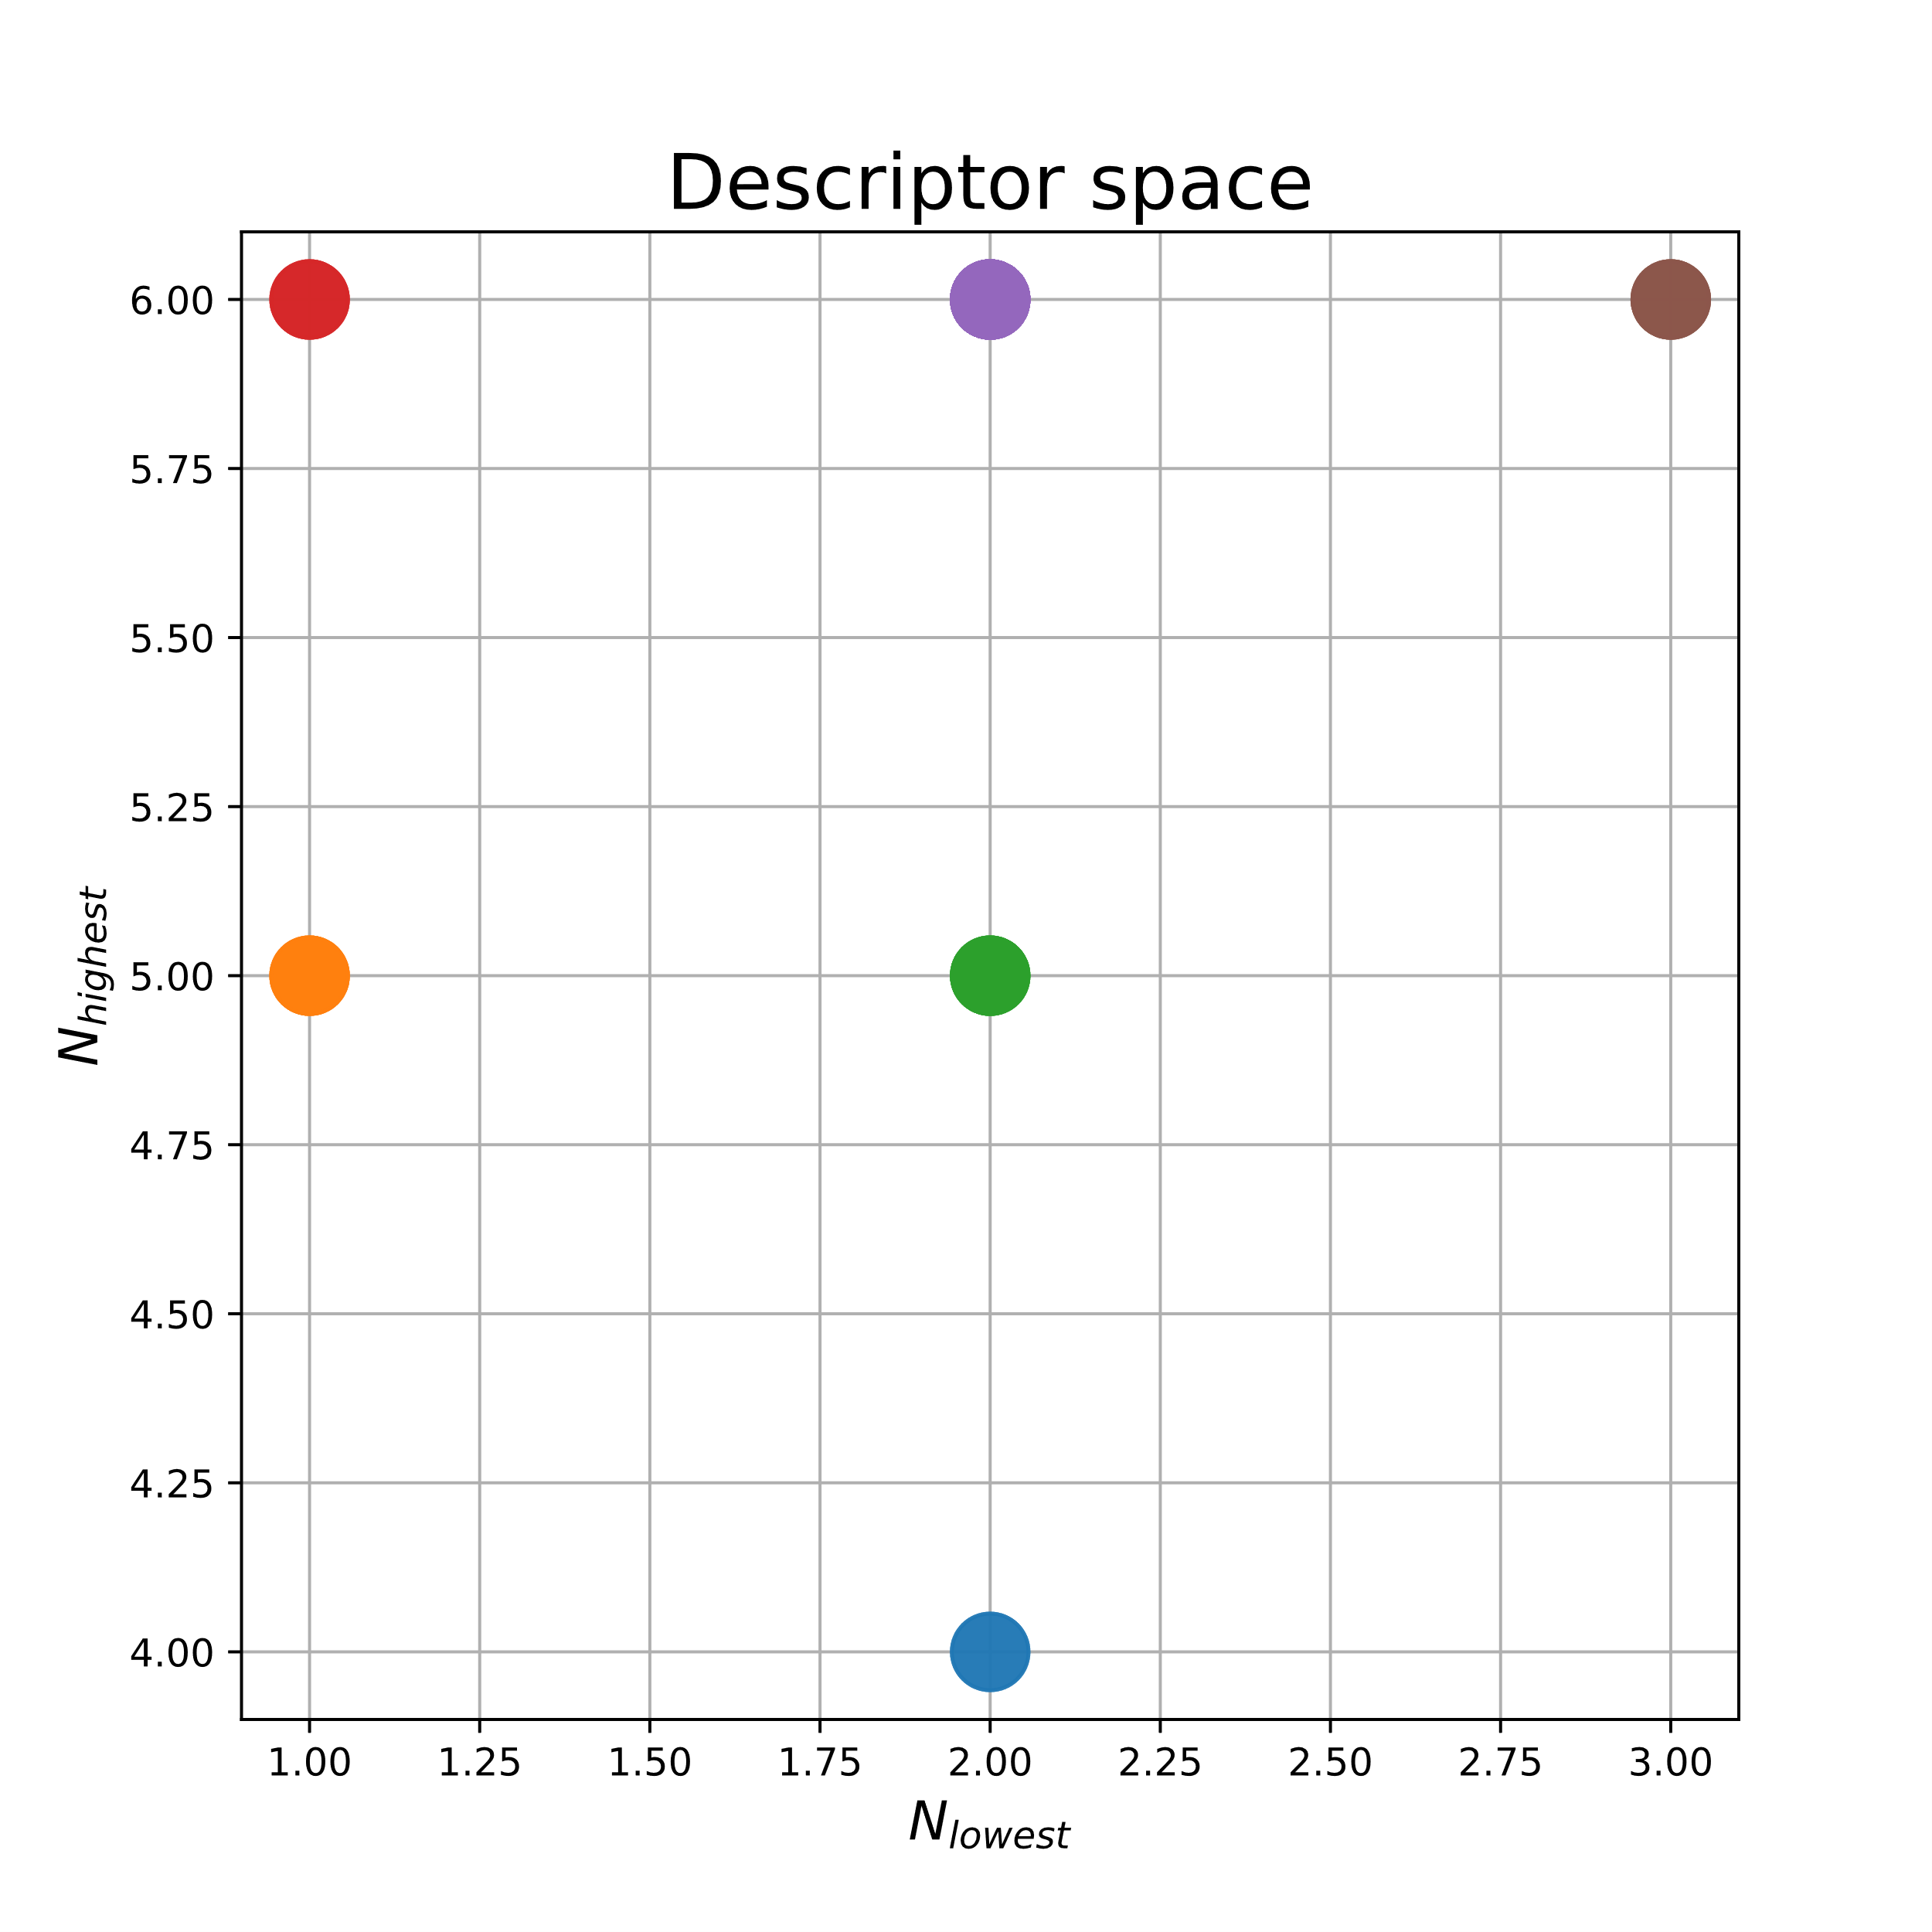
Distance Moments & Extreme neighbor counting

Slide 5
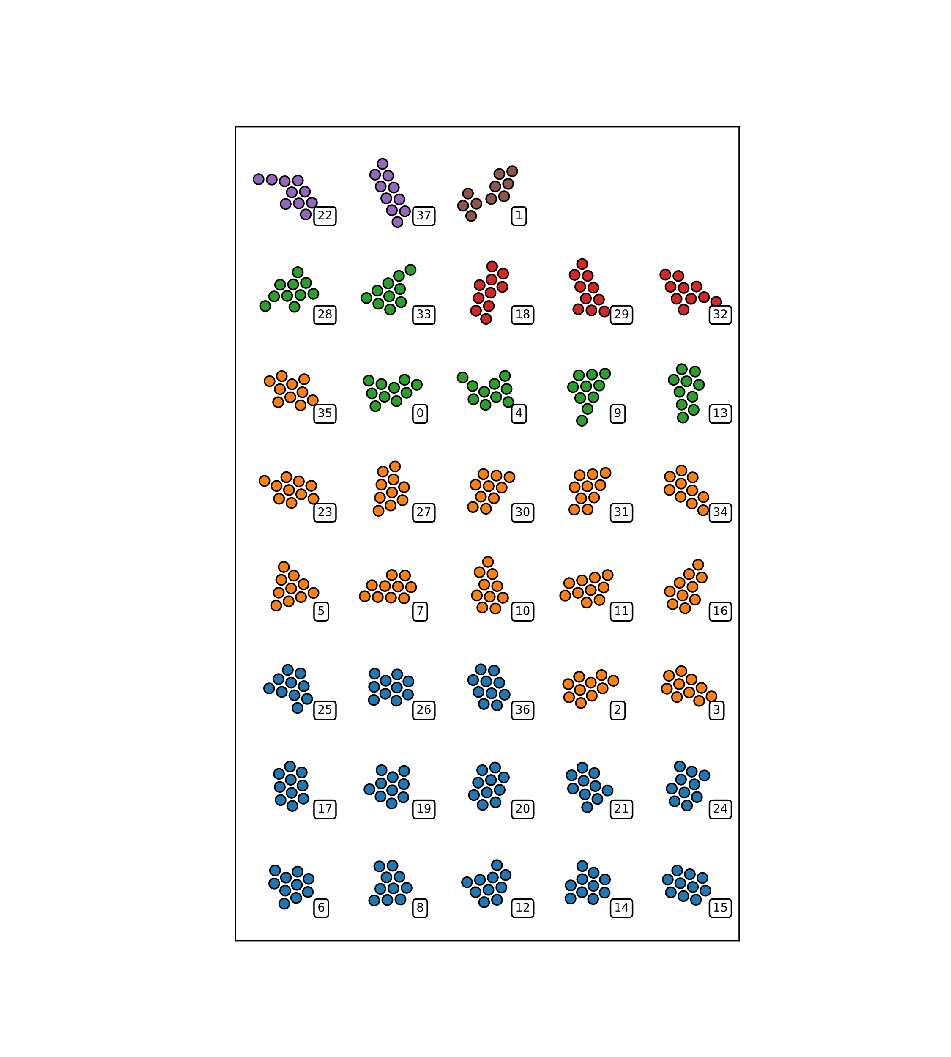
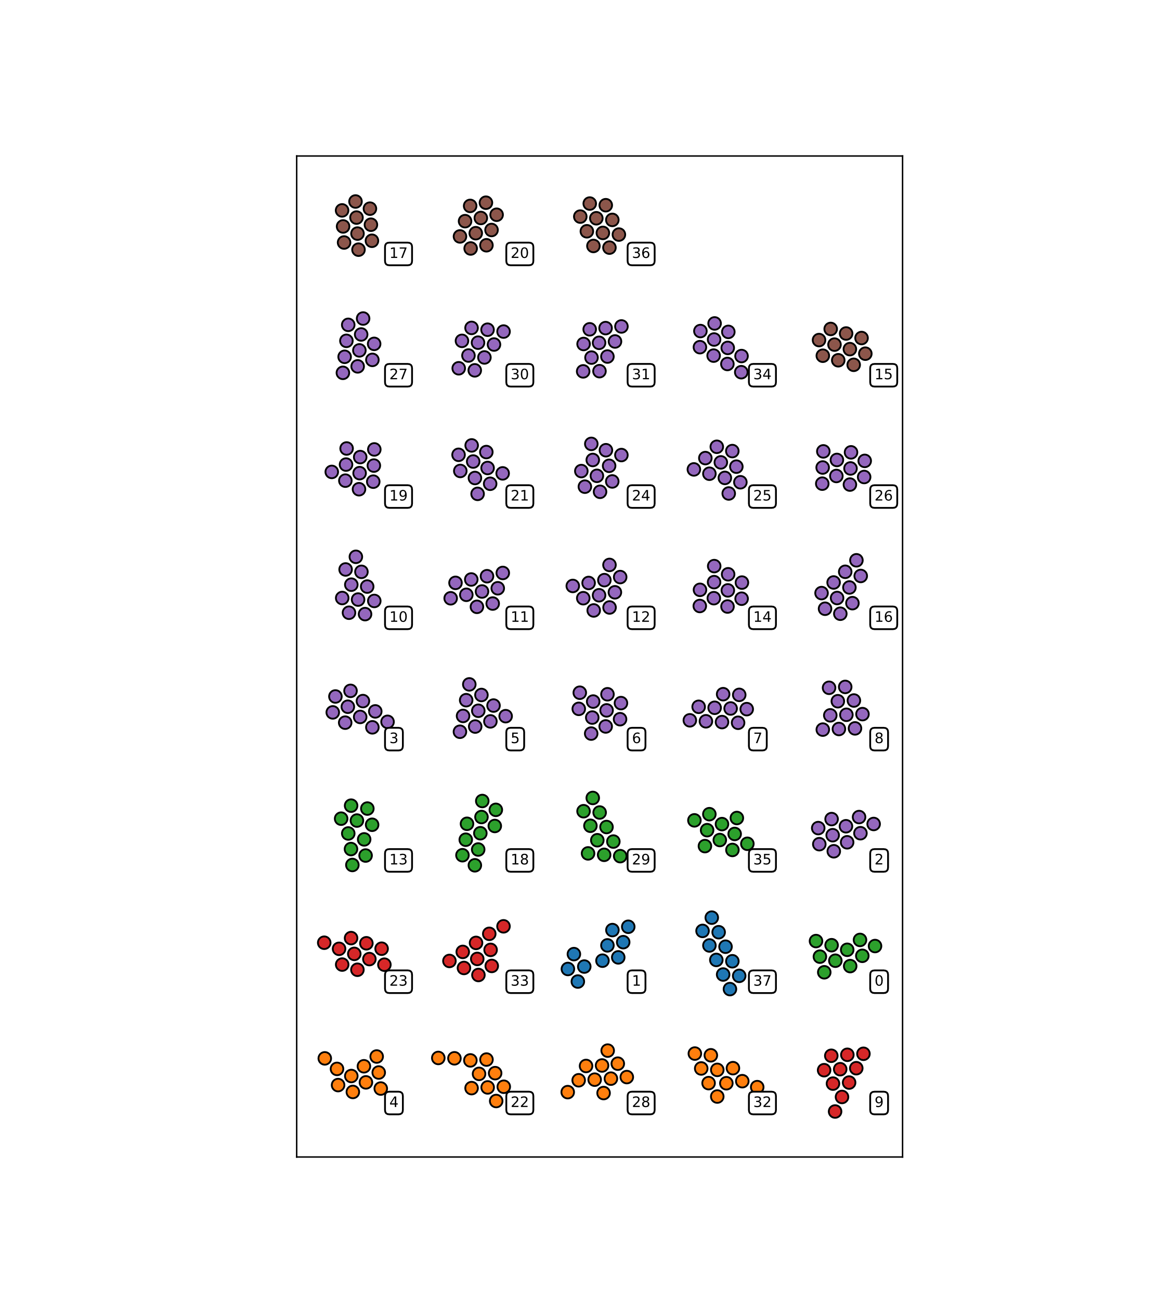
Distance Moments & Extreme neighbor counting

Slide 6
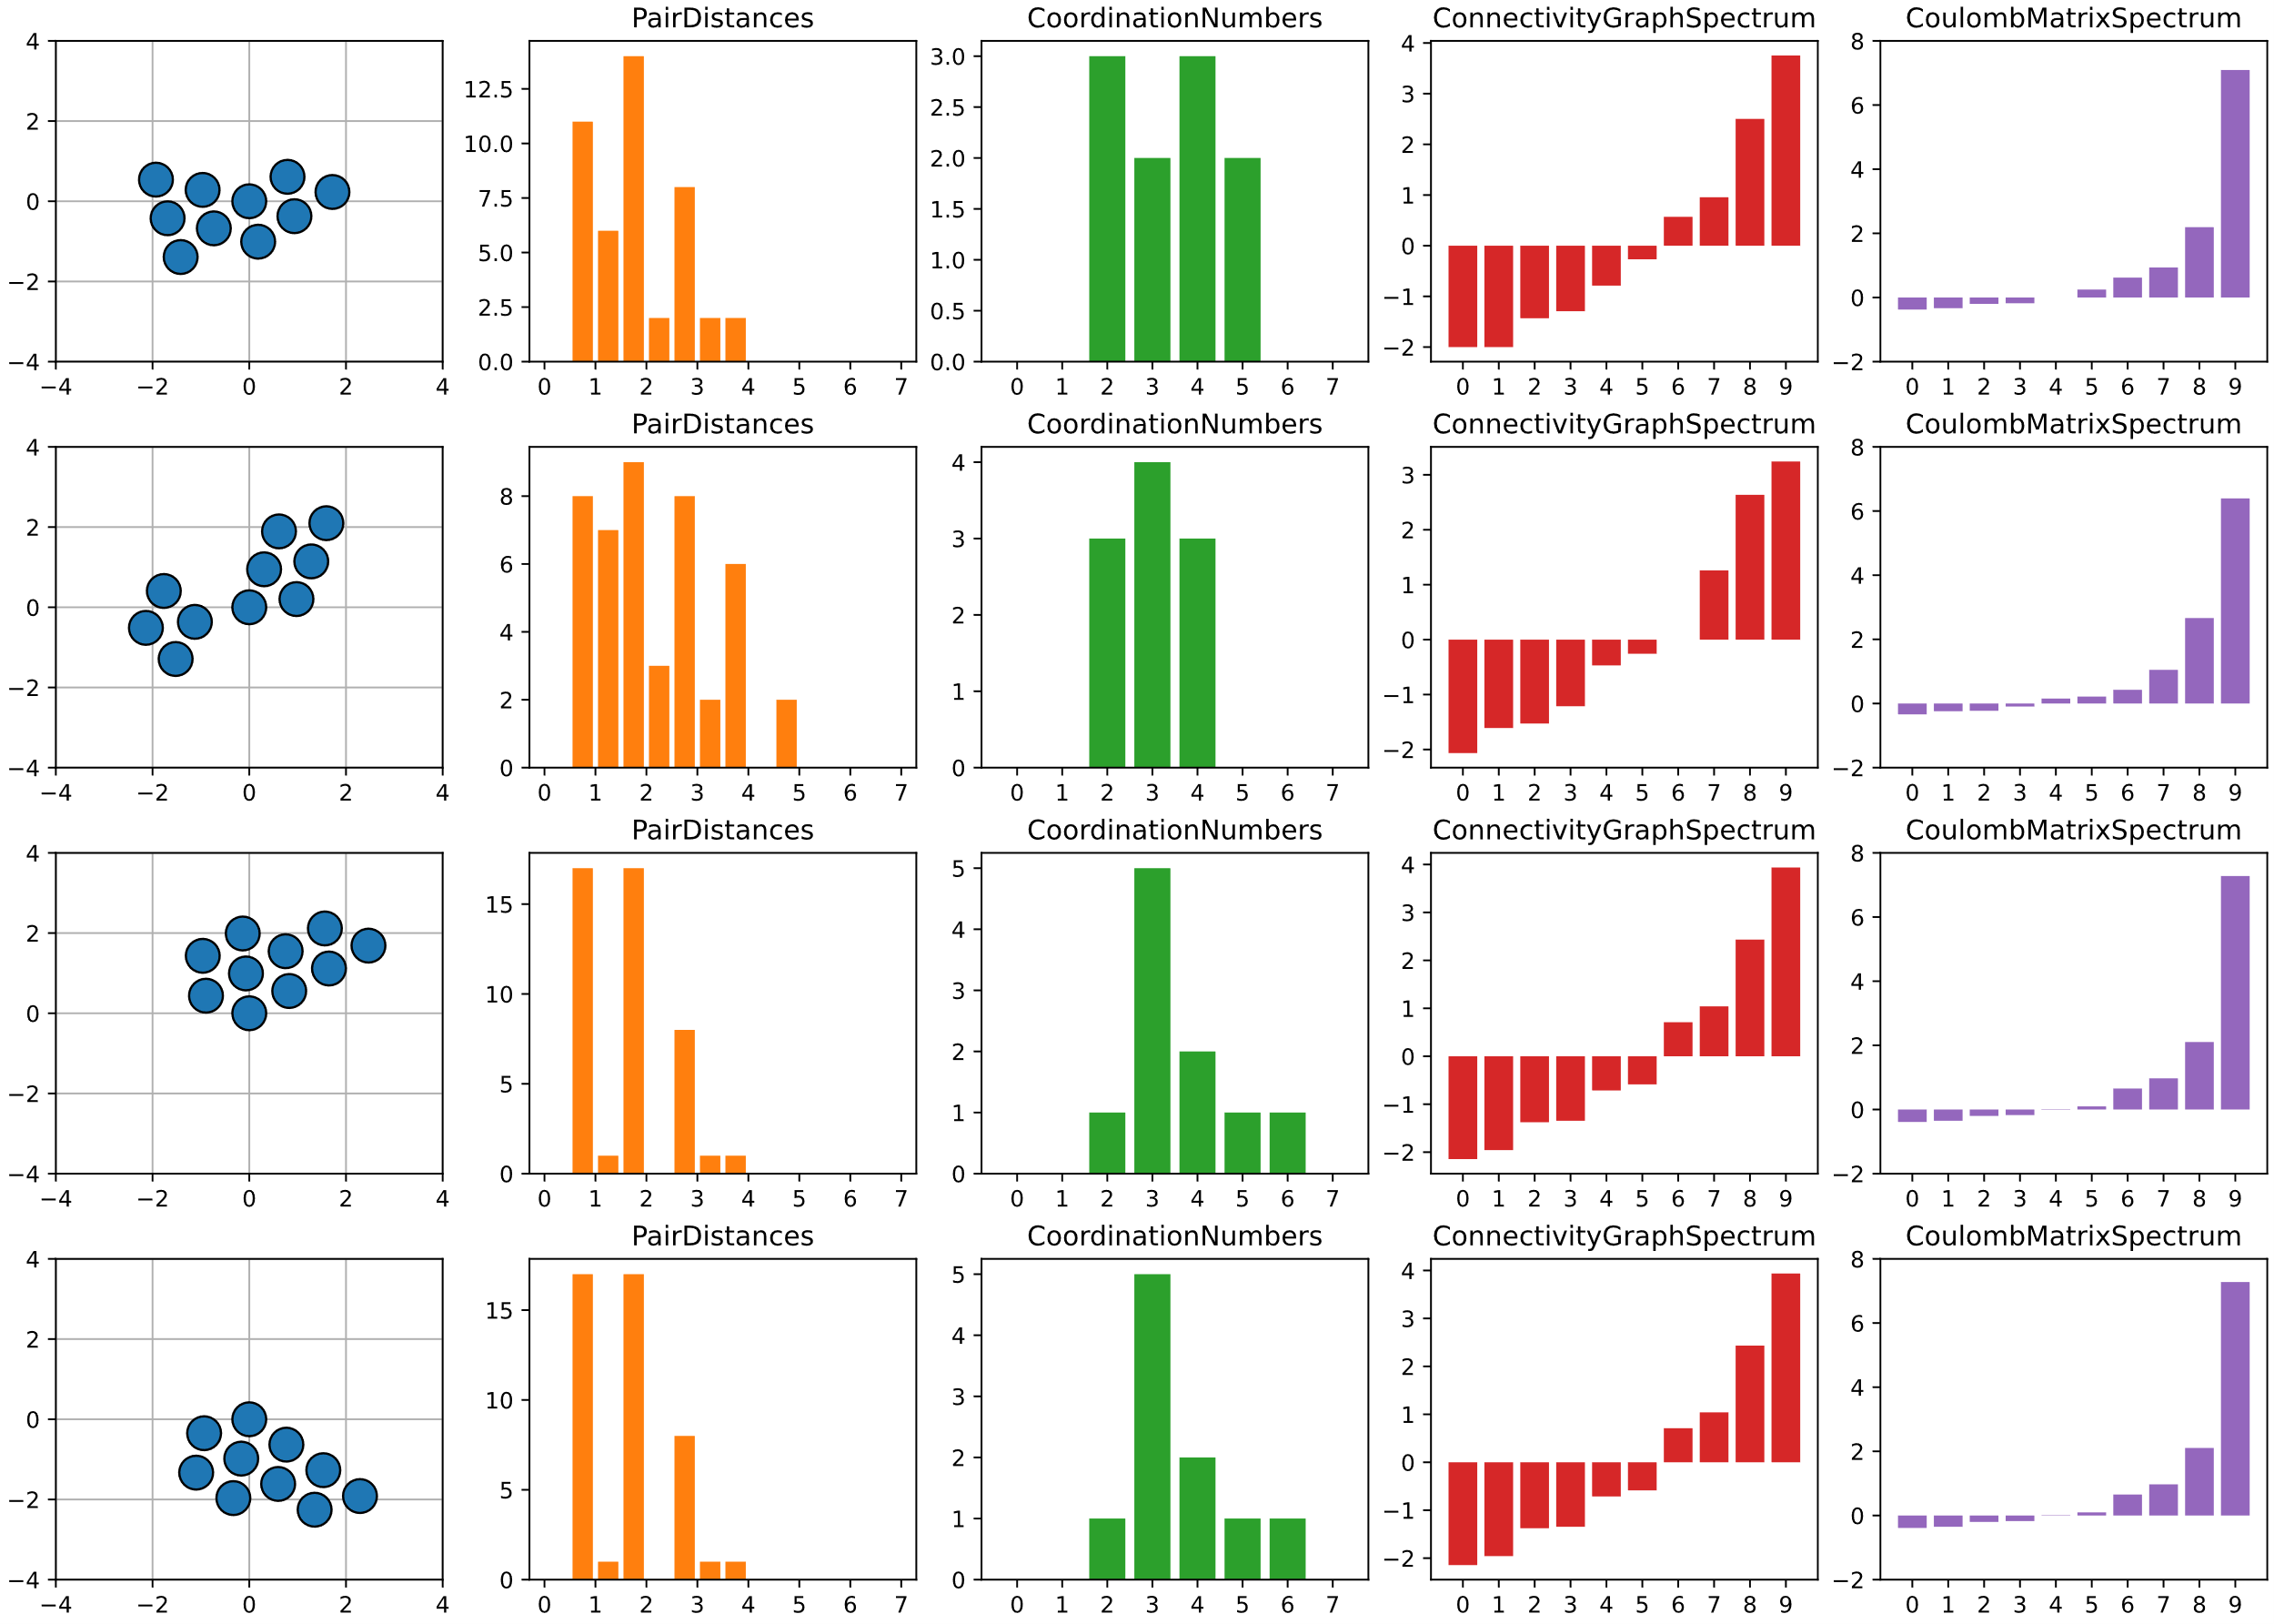
More ”expressive” descriptors
All are global descriptors

Slide 7
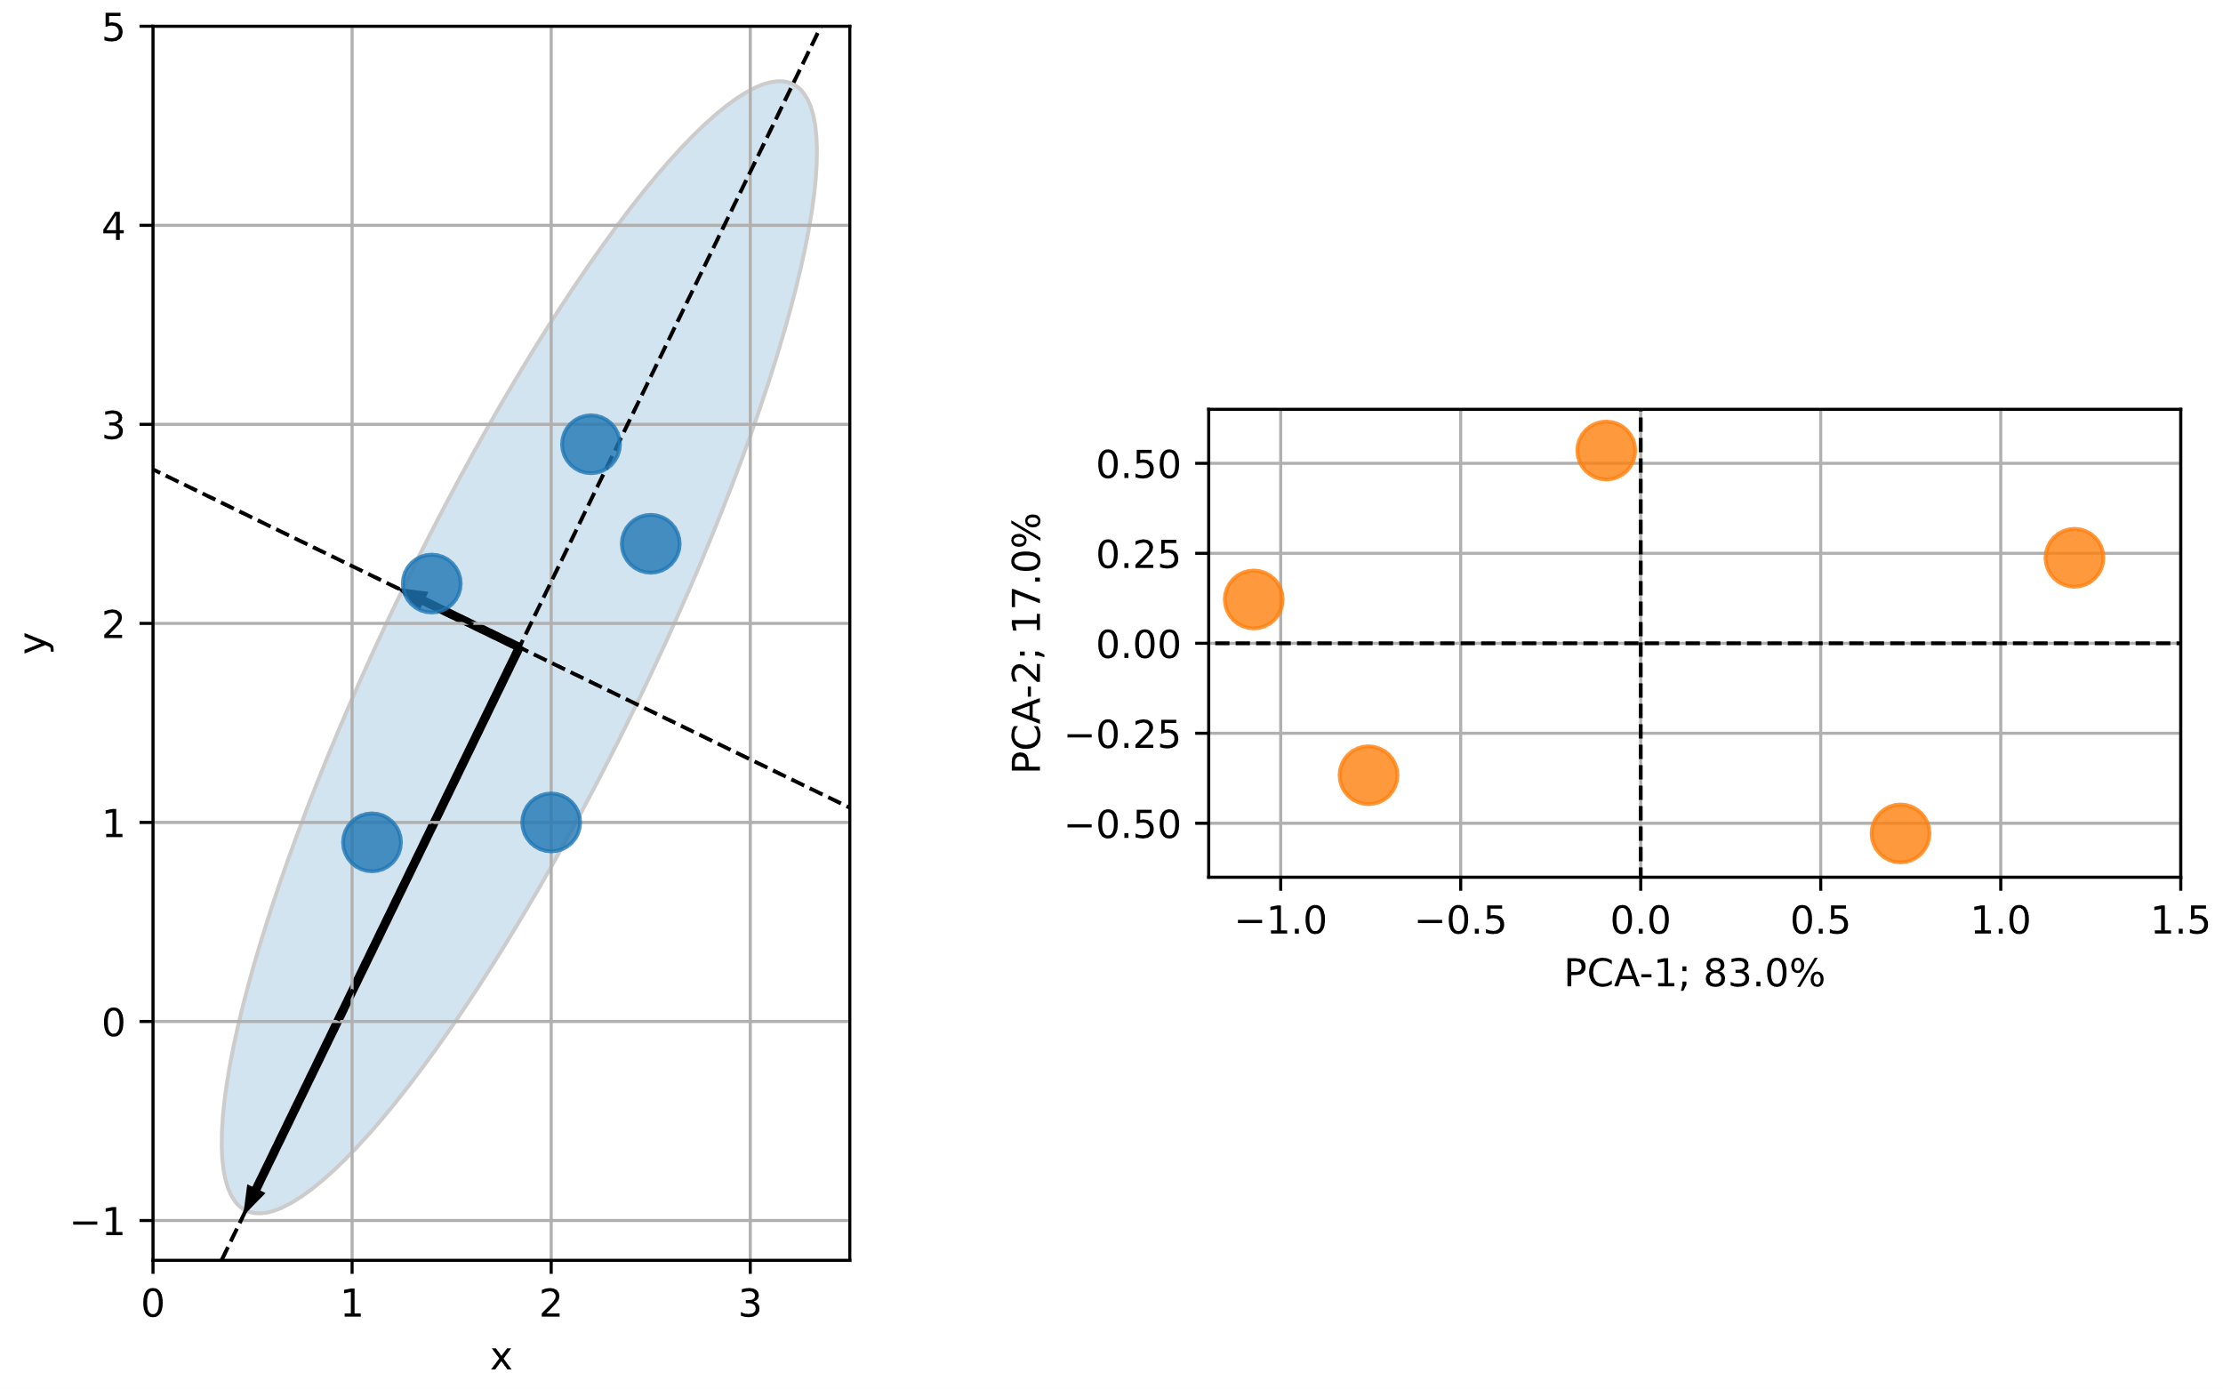
Principal component analysis (PCA)
Continuing with Coulomb spectrum.
We can no longer plot descriptors as before.
Luckily, we have PCA

Slide 8
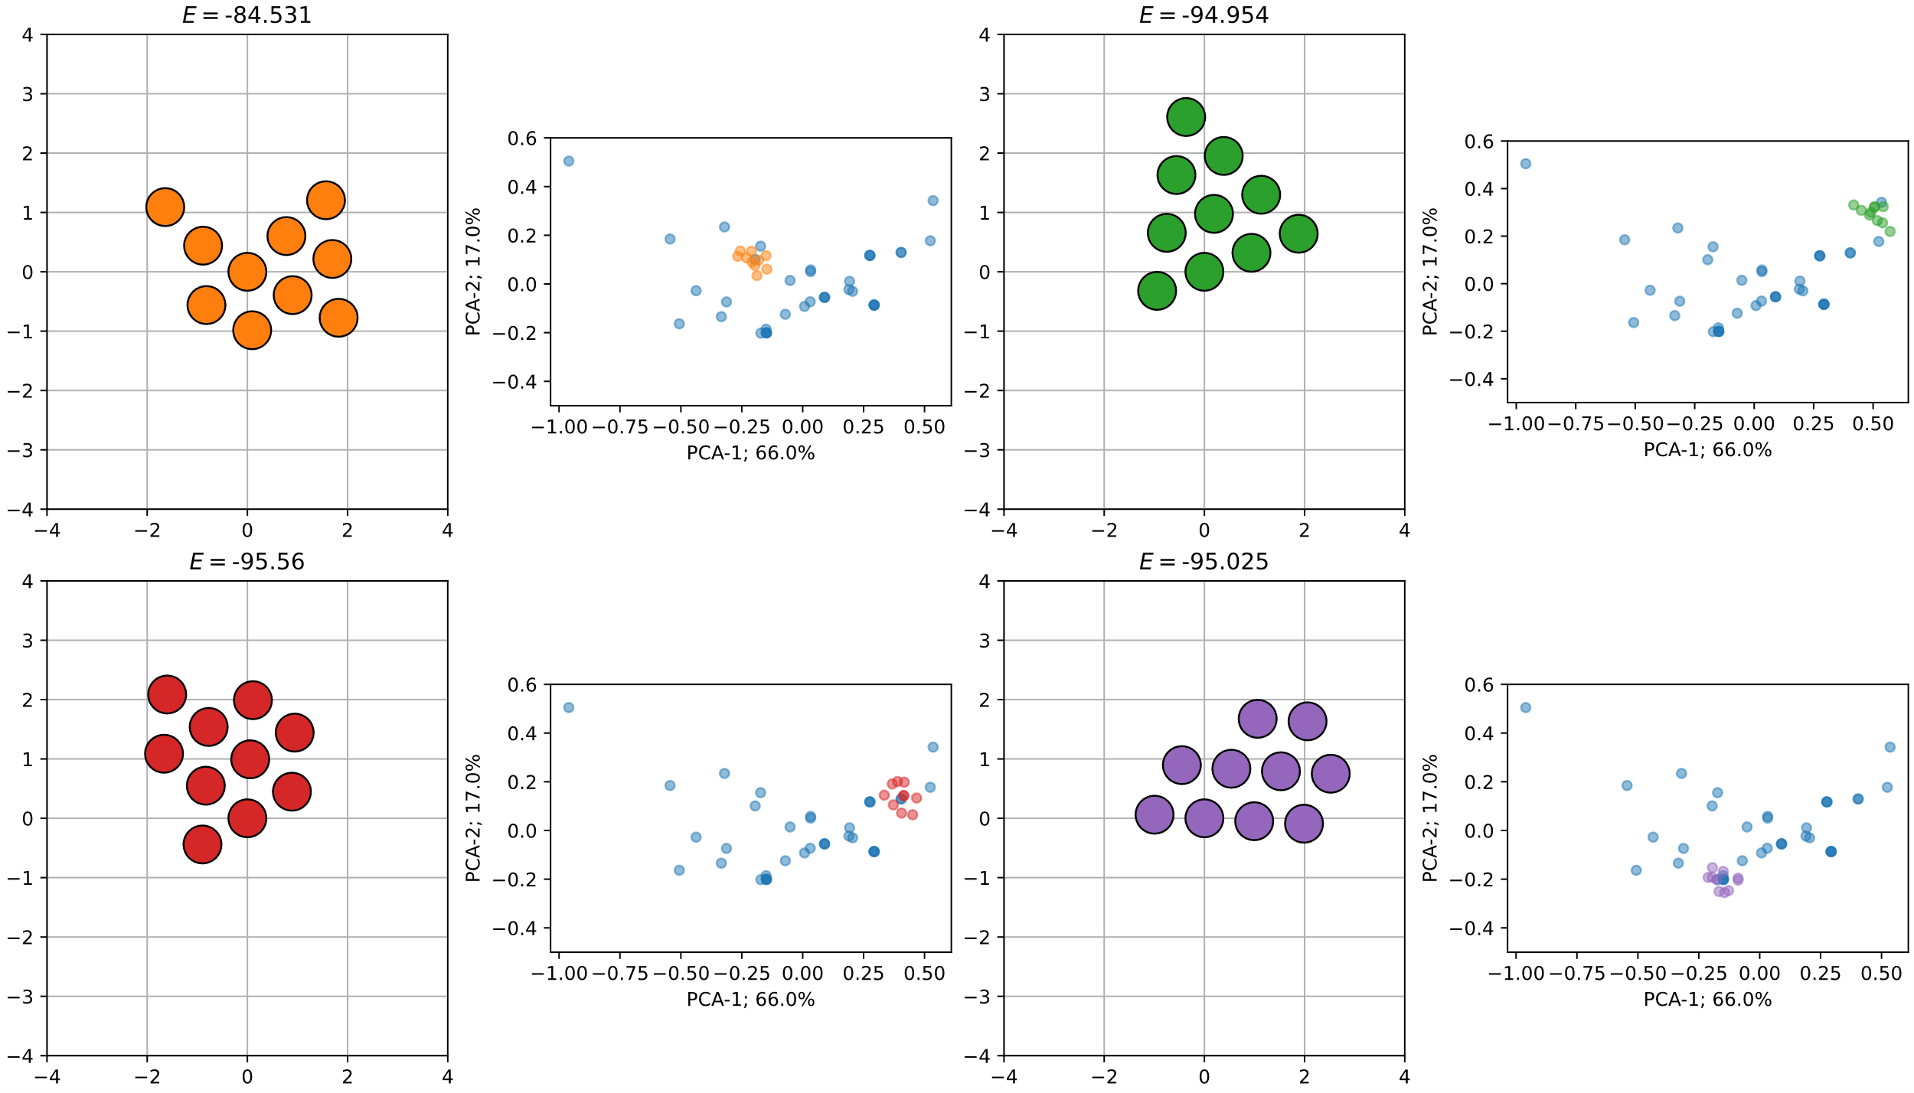
Principal component analysis (PCA)

Slide 9
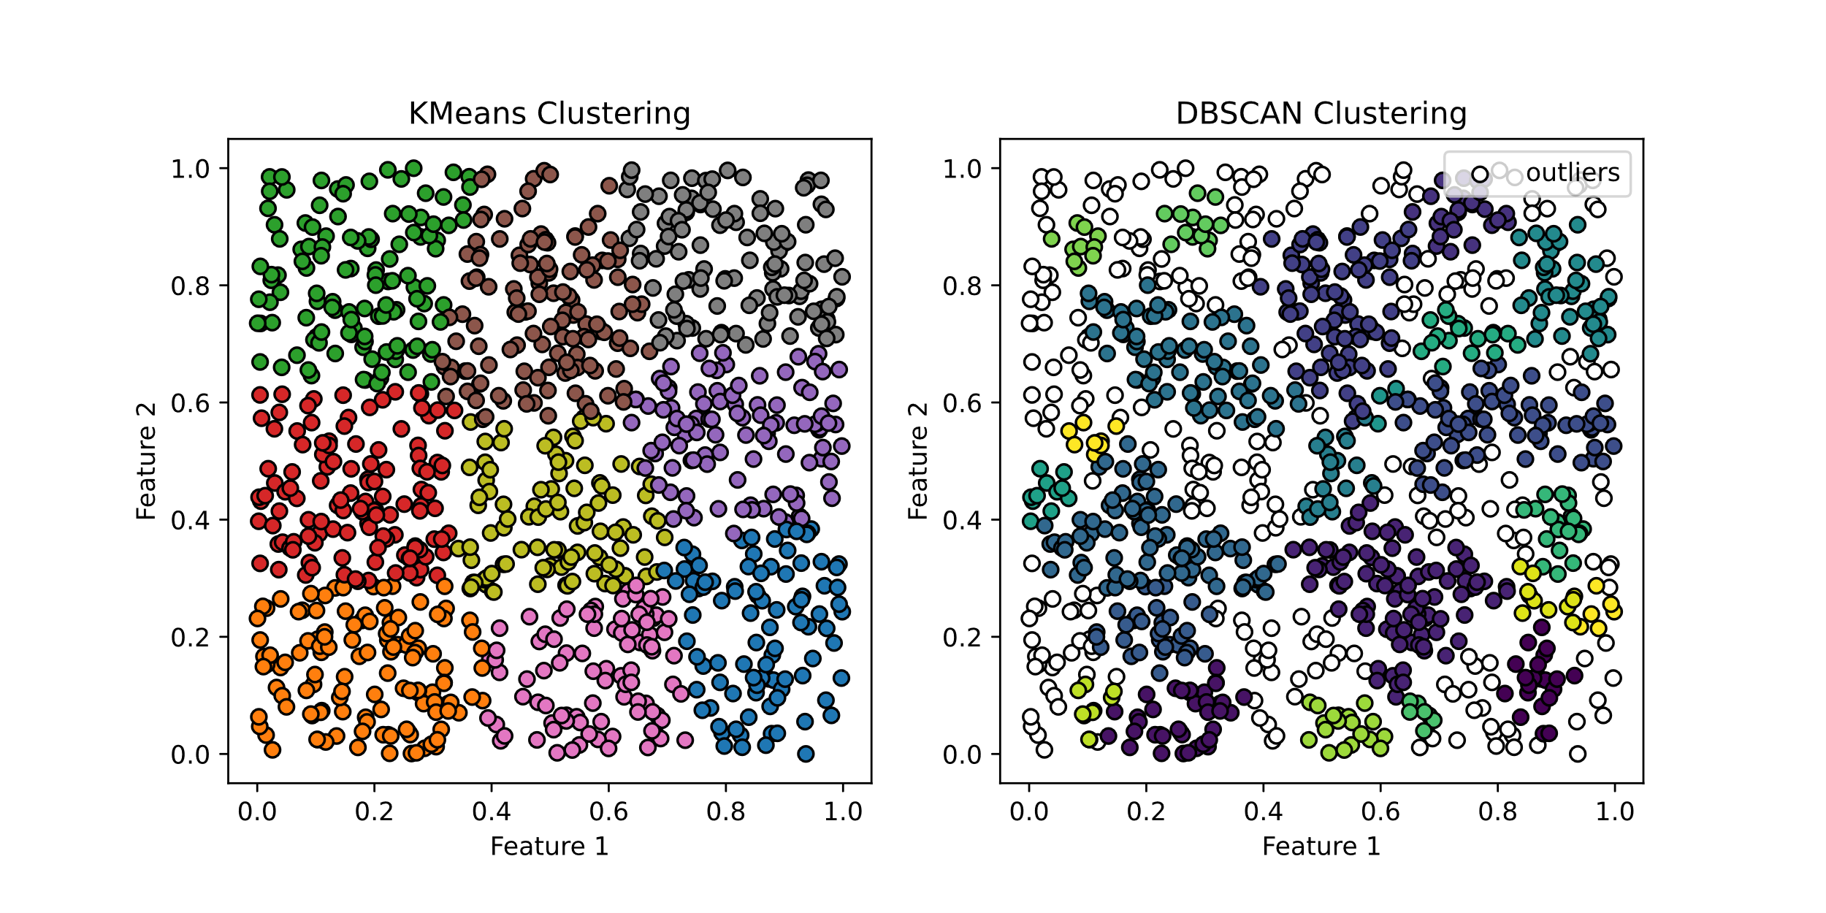
Unsupervised machine learning methods
Kmeans clustering → Centroid based
DBScan clustering → Density based

Slide 10
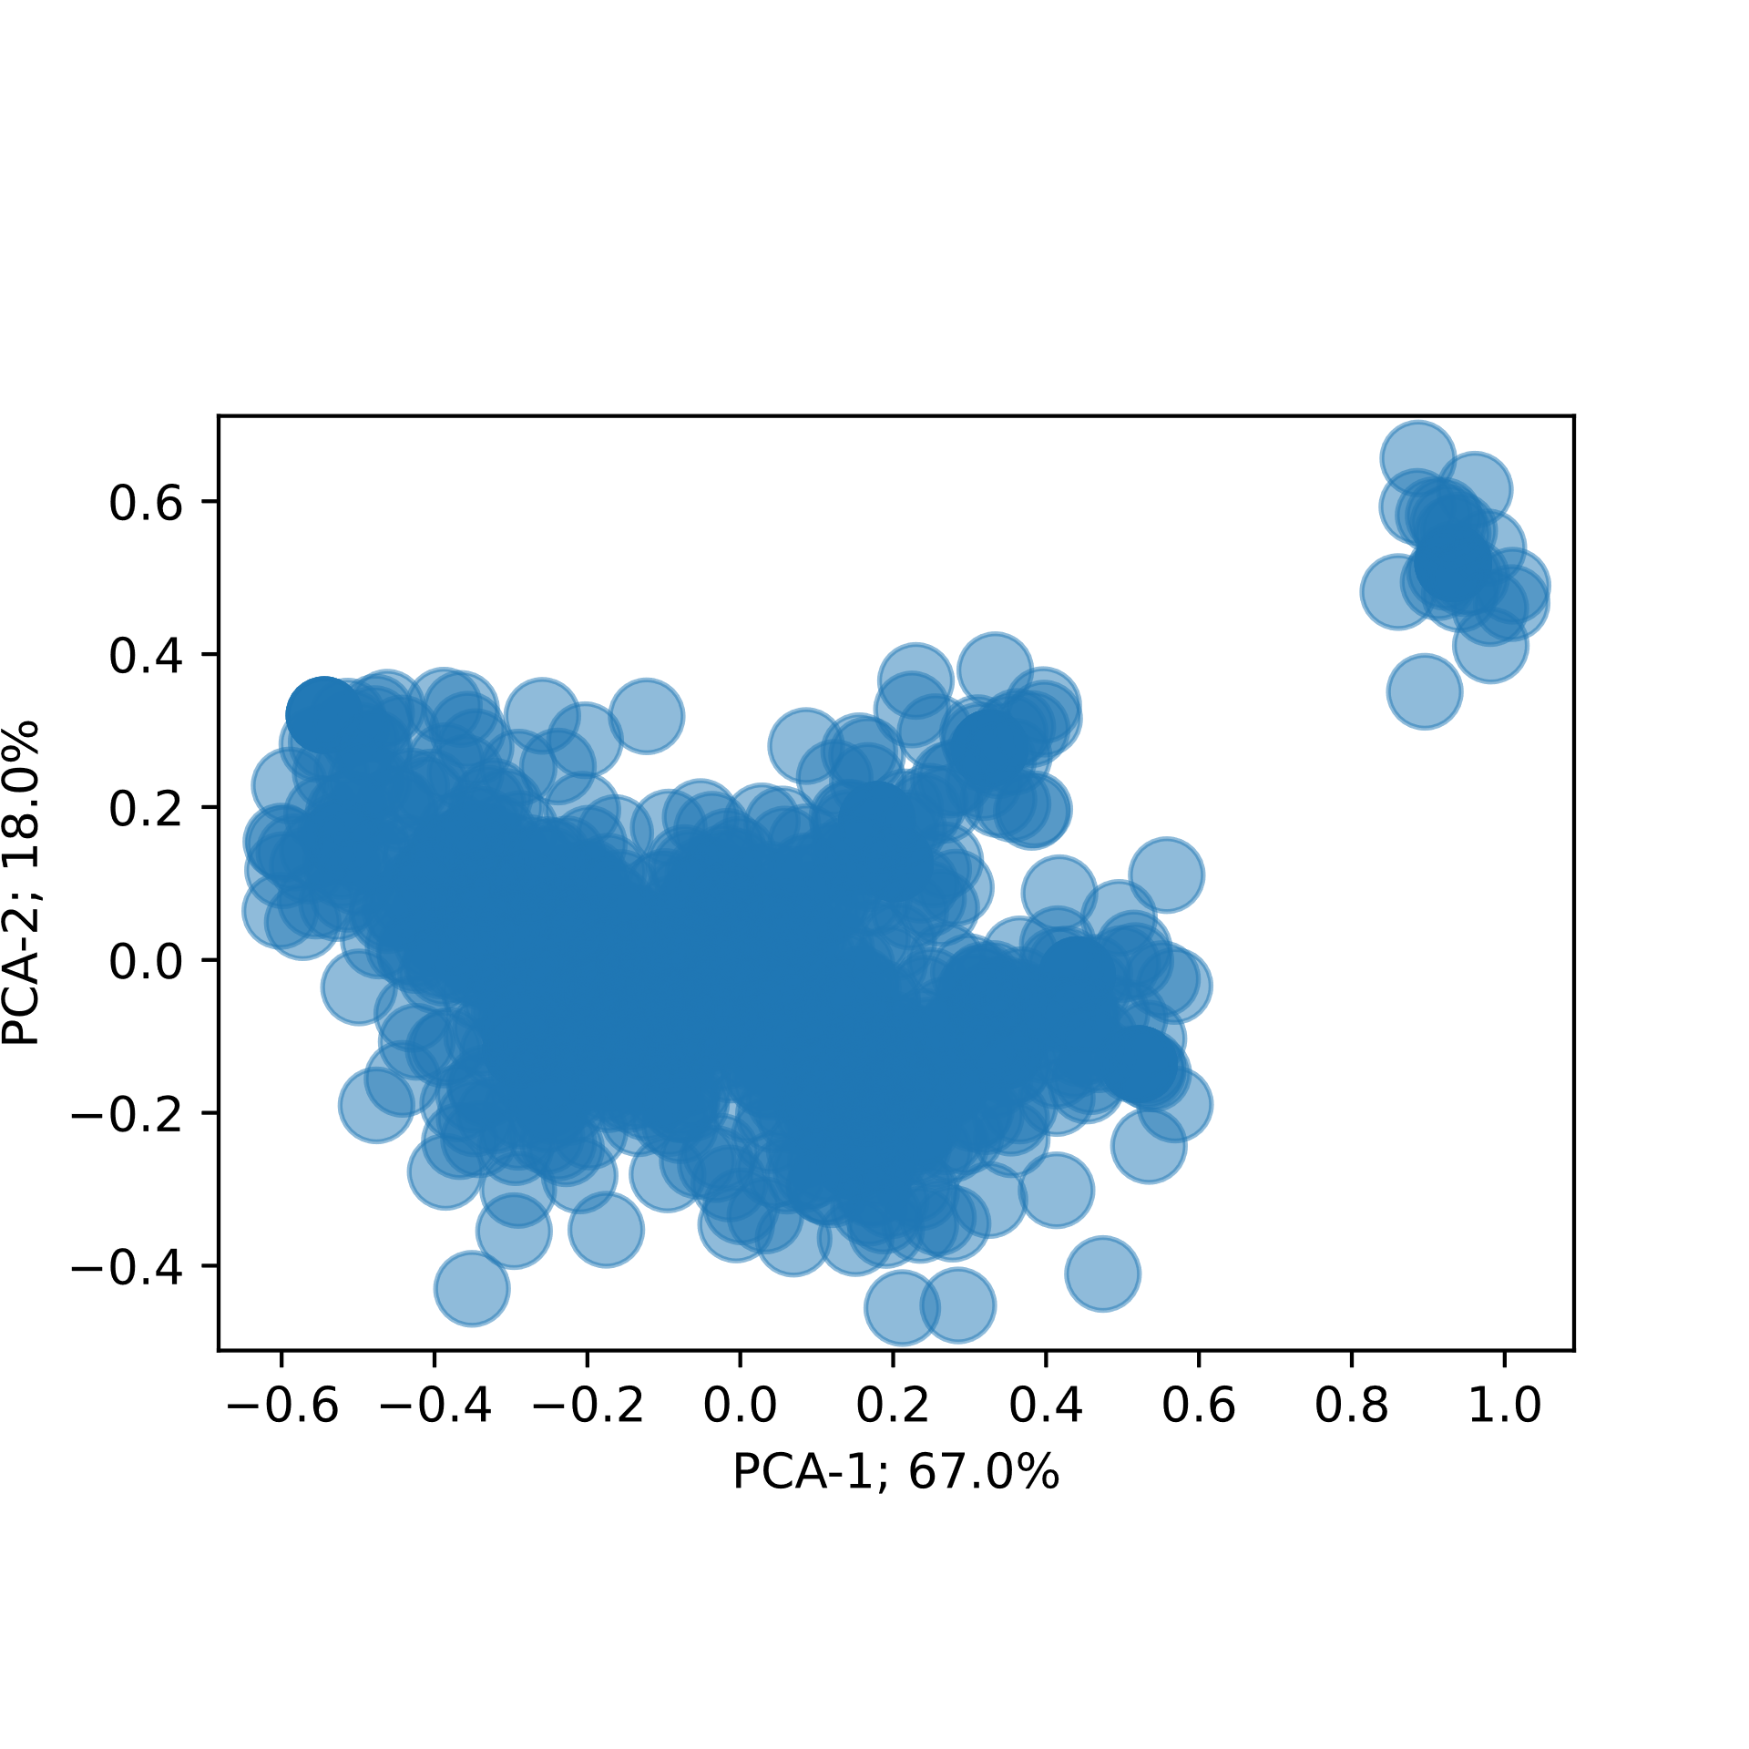
After Kmeans in feature space

Slide 11
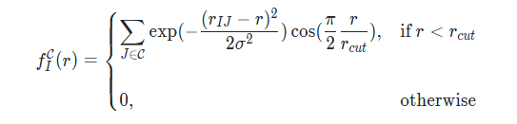
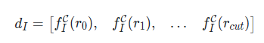
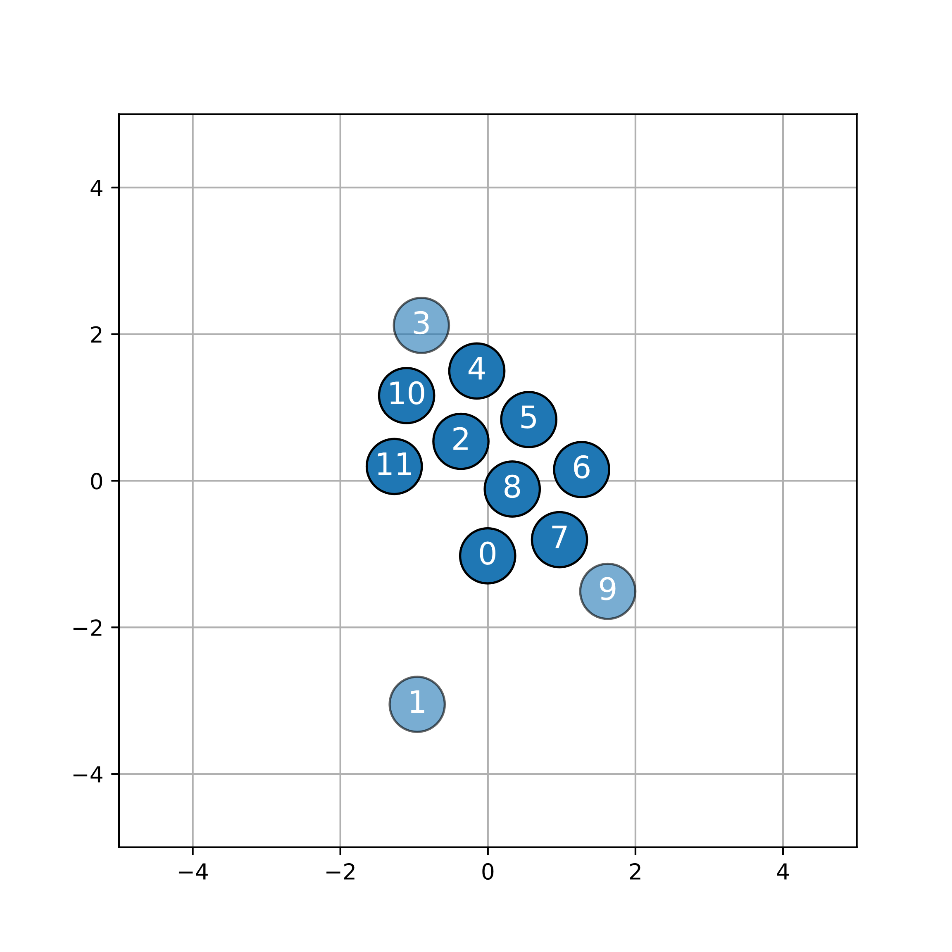
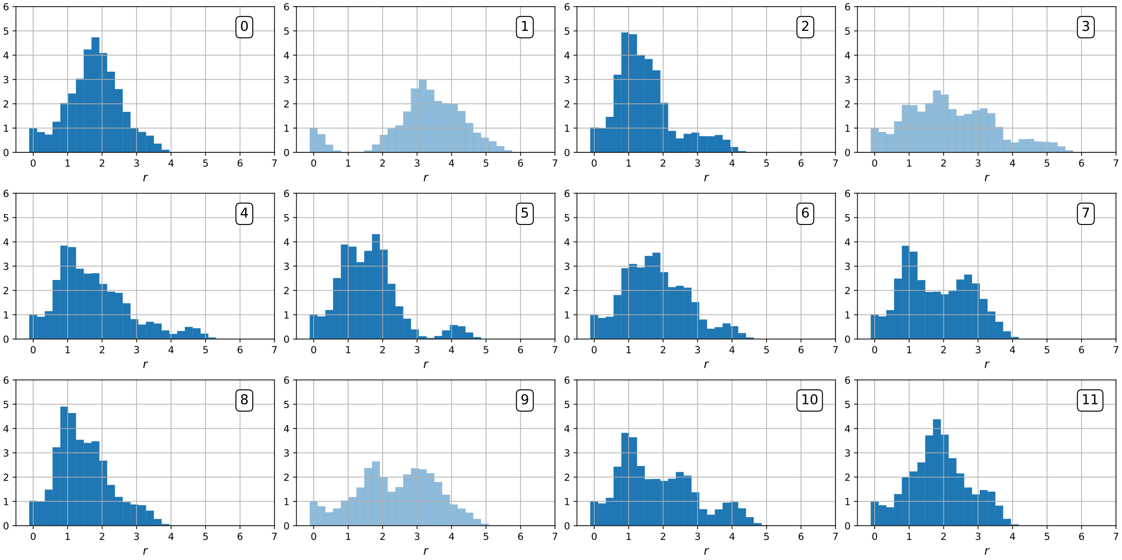
Supervised machine learning
New example: Make Neural Network do the classification
Minimize the Cross Entropy
Atomic level descriptor:

Slide 12
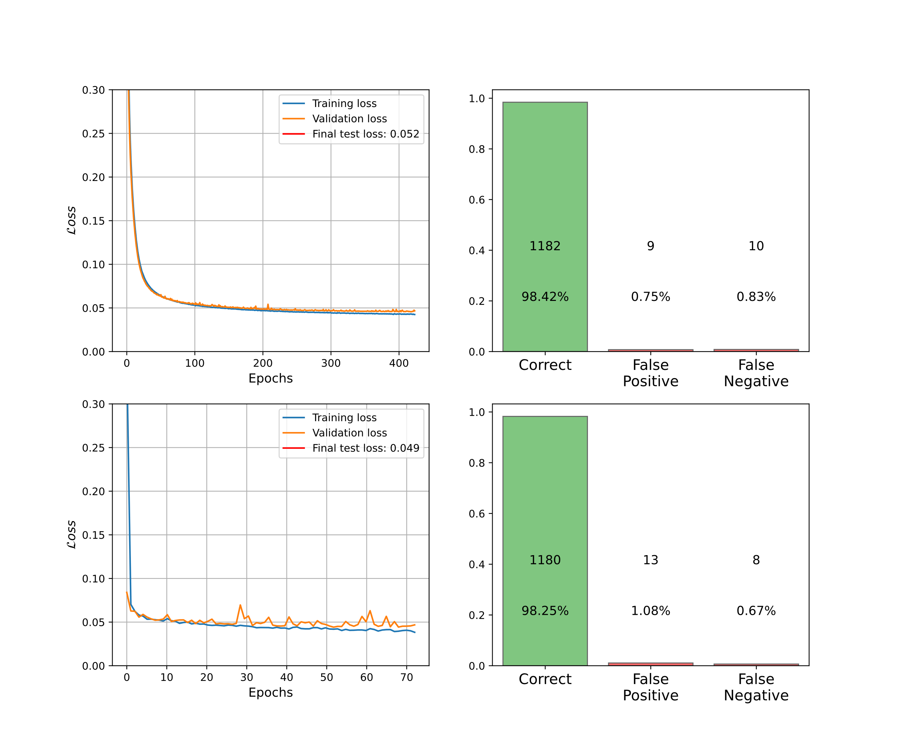
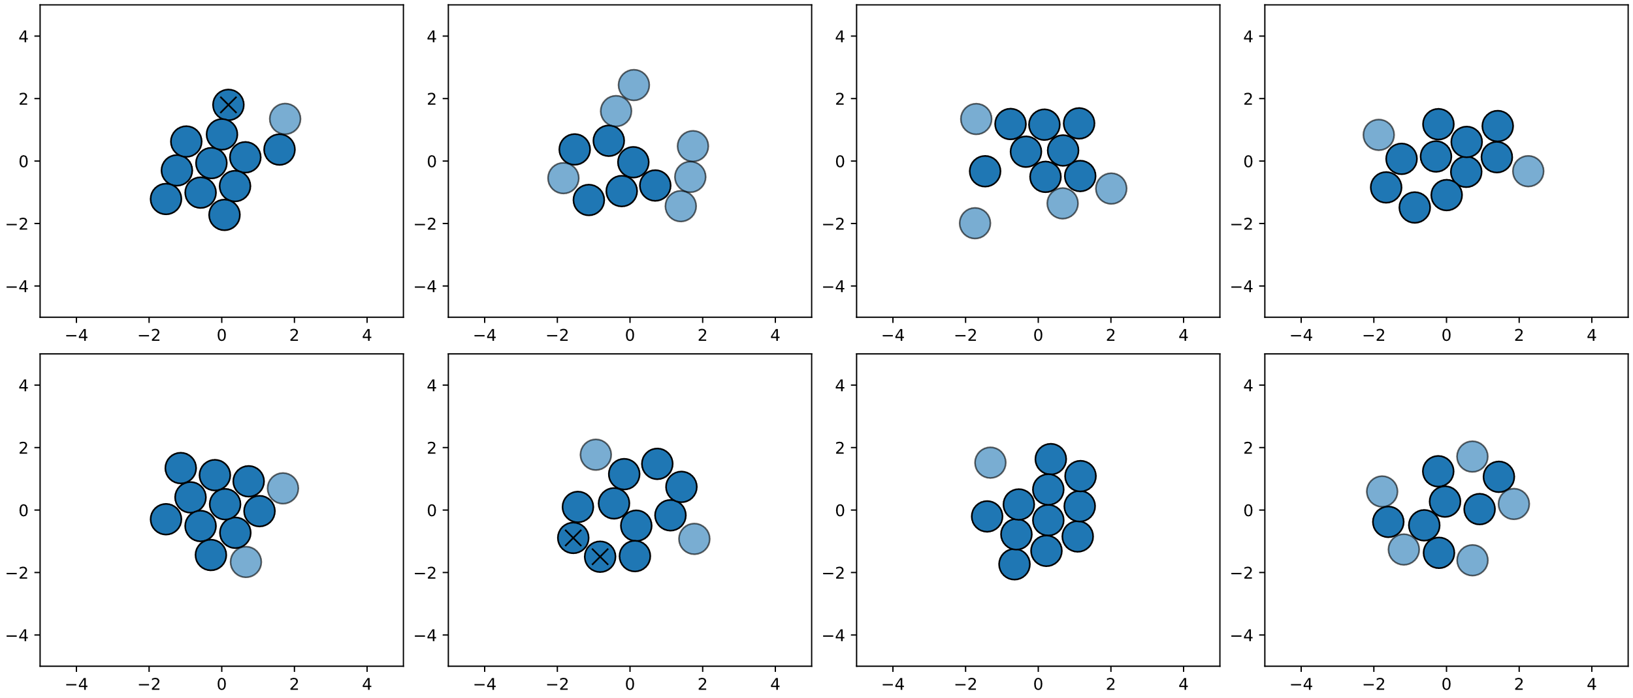
Supervised machine learning
Two NN models trained:
1-model: 1 hidden layer of 3 neurons
2-model: 6 hidden layers of 42 neurons

